Slide 1
“COMPLETE RESOURCES CORRECT SOLUTIONS”

Slide 2
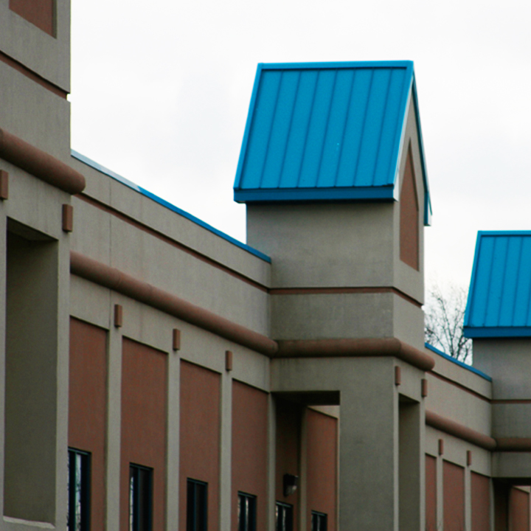
Southward Industrial Park Newark -Newark, NJ
Driven Purpose
CERON MANAGEMENT LLC
The seed for Ceron Management was planted in 1979 with one thought in mind:
Serve the entire Greater New York City Area with “Complete Resources Correct Solutions”
Ceron Management, LLC is a Design build, Construction Management and General Contracting Company.
We are committed to a well-managed project from its genesis. That commitment is evident in our quality, integrity, well-managed timelines and budgets in every project that we embark upon.
Our licensed and on-site professionals are available to assist with all the construction development and site needs.

Slide 3
Exxon Refinery Linden, NJ
Beginning
In September of 1979 at the Exxon Refinery in Linden, New Jersey, Mr. Hector Quijano committed himself to learn and perform his work with the idea that one man (and eventually one company) could and would provide the construction industry with:
“Complete Resources Correct Solutions”
His personal commitment paid off quickly and Mr. Quijano became a team leader within 3 months of starting his career in the Industrial Commercial Construction Industry.
In 1980, Mr. Quijano’s leadership and commitment earned an invitation and job offer of Site Super overseeing the logistics of all projects at the U.S Army Picatinny Arsenal Corp of Engineers, New Jersey. Discipline and an eye for detail was essential to his success at the Arsenal. The U.S. Army Picatinny Arsenal is an internationally acknowledged hub for the advancement of armament technologies and engineering innovation.

Slide 4
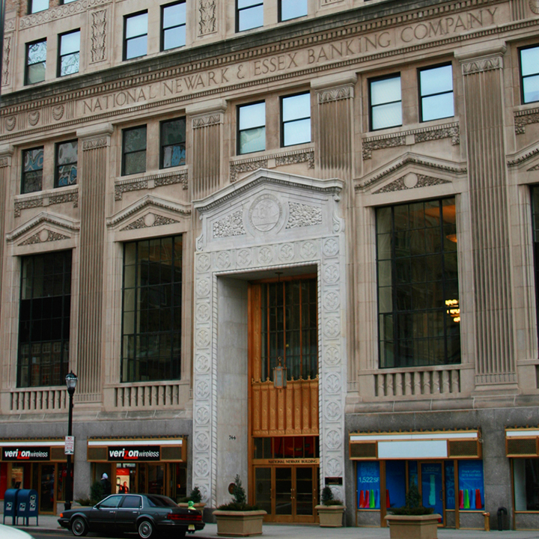
National State Bank Newark, NJ
Early Management History
From 1983 to 1989, after successfully completed his task at the U.S Picatinny Arsenal, Mr. Quijano was offered to oversee and accepted the following ground up, renovation and addition projects:
Historic National State Bank Building Newark, NJ 1986
Trenton State House Historic Renovation Trenton, NJ
Trenton State Prison Trenton, NJ
Clinton Women State Prison Clinton, NJ
Pathmark Supermarkets throughout NJ
Shoprite Super Markets throughout NJ
Kings Supermarkets throughout NJ

Slide 5
Gateways Newark, NJ
Early Management History
1983-1989
Gateway Plaza I, II, III and IV Newark, NJ.
Holiday Inn, Marriott, Hilton and Hyatt hotels throughout New York and New Jersey
Linden, NJ General Motors 2 separate robotic renovation projects.
Rutgers University New Brunswick, Newark and other locations throughout NJ
Merck, Shearing Plough, Sandos, and other NJ Pharmaceutical Companies
Johnson and Johnson Office and Labs through NJ
Butler Nursing Home Butler, NJ

Slide 6
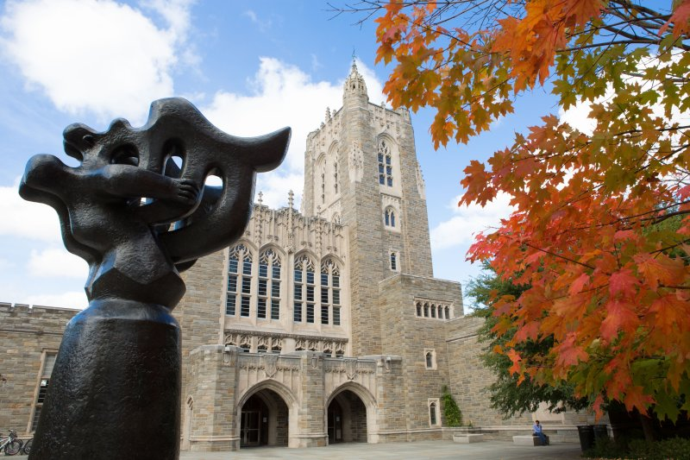
Princeton University Princeton NJ
Early Management History
1983-1989
Princeton University Princeton, NJ
National State Banks throughout NJ
Trenton Museum Trenton, NJ
Newark Penn Station Newark, NJ
Trump Plaza Hotel and Casino Atlantic City, NJ
Sparta Court House Sparta, NJ
Livingston Library Livingston, NJ
Loreal Manufacturing Clark, NJ

Slide 7
Newark International Airport / Monorail
The Company History
Ceron Management, LLC was established as a Commercial Construction Company in 1989. At that same time Mr. Quijano’s again was offered to oversee and accepted the renovation project at Newark International Airport now known as the “Newark Liberty International Airport” from 1990 to 1995, work that included:
American Airlines Terminal A New Admirals Club
AA New Baggage Area
AA Ground Control
U.S. Air
United Airlines Terminal A
The Newark Airport Monorail Train
Terminal B Delta Air Lines
Terminal C International Continental Air Lines

Slide 8
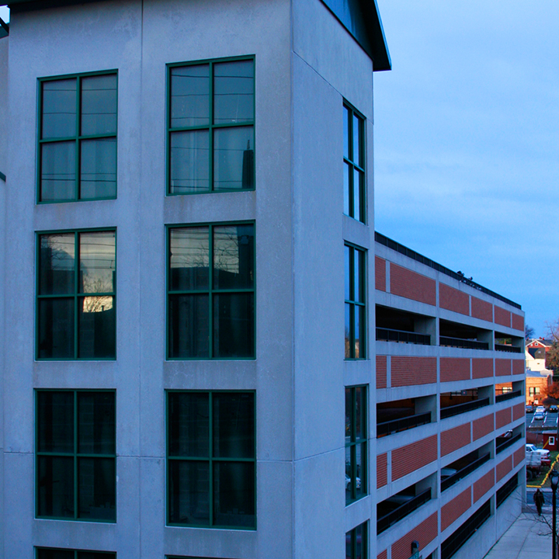
Elizabeth Parking Garage Elizabeth, NJ
History, continued
Ceron’s site management experiences and contract innovation did not end at Newark Liberty International Airport. From 1995 to 2000 Ceron Management’s experience continued to grow with:
Elizabeth Parking Garage Elizabeth, NJ
Union County Economic Development Corporation, Elizabeth & Union, NJ
B’nai Israel Temple Millburn, NJ
Hernandez Travel Agency, Newark, NJ
Southward Industrial Park, Newark NJ
Polyurethane Specialties Lyndhurst, NJ
Newark National Bank (Historic Renovation), Newark, NJ 1998
Caviar Russ, Madison Ave. NY, NY
Embassy and home to the Ambassador to the United Nations from The Country of Tunisia
U-Haul Company Truck & Storage Rental throughout NJ

Slide 9
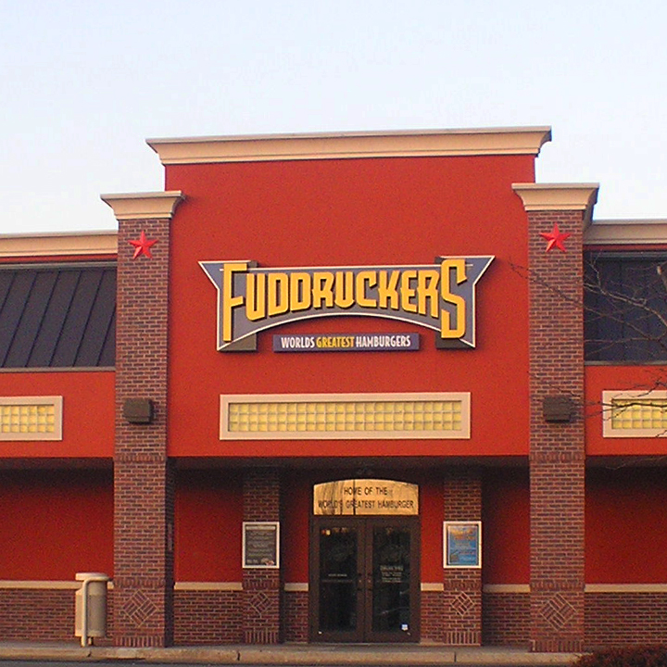
History, continued
From 2000 to 2019 Ceron Management completed:
Fuddruckers Restaurant, Succasunna, NJ
Ridgewood High School Ridgewood, NJ
Carteret Elementary School Carteret, NJ
TD Banks throughout NJ
PNC Bank Washington, NJ
New York Sports Club Hoboken, NJ
Johnny Blaze Restaurant Cali, Colombia S.A.
St. Barnabas Medical Center Burn Unit Livingston, NJ
Design Built Operating Engineers Local
825 Springfield, NJ
University Diner, Union, NJ
Firebird Restaurant Eatontown, NJ

Slide 10
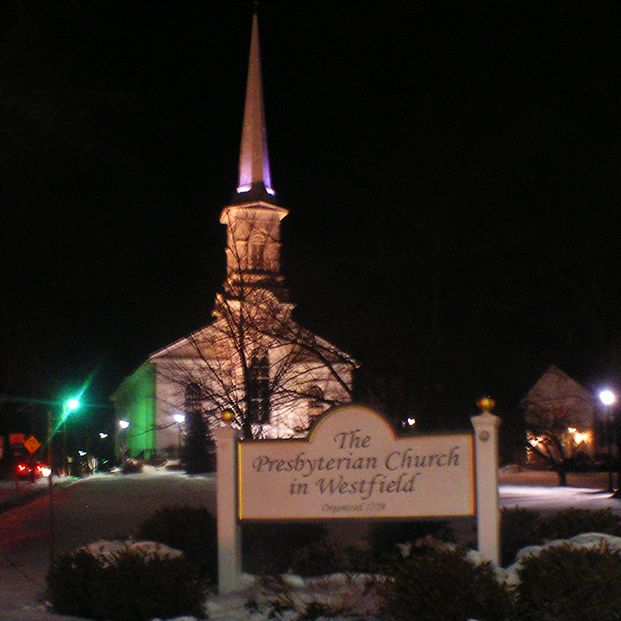
History, continued
From 2000 to 2019 Ceron Management completed:
Westfield Presbyterian Church Westfield, NJ
Insurance Claim Operating Engineers Local 825 Springfield, NJ
Cintas National Account in: Corpus Christi, Texas; Runnemede, NJ; Nashville, TN
Extra Storage Space, Harrison, NJ
Hand & Stone Spa, Bayonne, NJ

Slide 11
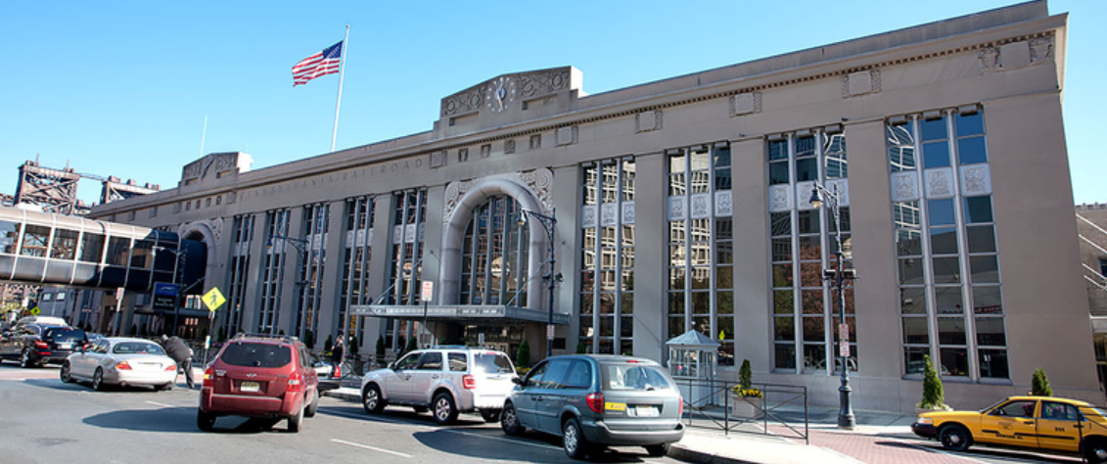
Penn Station Newark, NJ
Areas of Expertise
Educational
Banks
Places of Worship
National/International Restaurants & Franchises
Health / Nursing Homes
Public Safety
Office Buildings
Retail/Malls
Manufacturing Plants
Correctional Facilities
Public Transportation
Airports
Supermarkets
Museums

Slide 12
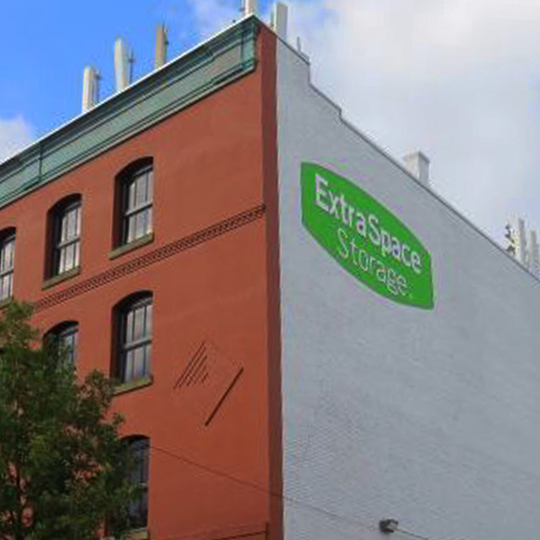
National Accounts
Areas of Expertise
Storage Facilities
National Accounts
Parking Decks
Pharmaceutical
Casinos
Diplomat’s Office and Homes
Industrial Catering Kitchens
Industrial Parks
Manufacturing
Commercial Insurance Claims

Slide 13
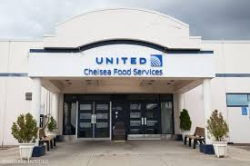
Design Build
Ceron Management’s design build projects include:
Chelsea Catering (Continental Air Lines), Newark, NJ -- James Guerra Architects PA
Scrap Metal 901 E. Grand St., Elizabeth, NJ -- James Guerra Architects PA
Operating Engineers Local 825, Springfield, NJ -- James Guerra Architects PA
Extra Storage Space, Harrison NJ -- Scott Armstrong. program manager, construction and property development

Slide 14
Partners/References
James Guerra Architects PC Andy Levine 908-355-2555
Operating Engineers Local 825 James Chiurazzi 973-508-3441
Extra Space Storage Scott Armstrong 609-304-4160

Slide 15
“COMPLETE RESOURCES CORRECT SOLUTIONS”
Ceron Management, LLC
Address: 65 Springfield Ave. Springfield, NJ 07081
Website: www.ceron.us.com
Email: newproject@ceron.us.com
Phone: 908.220.9080
Key Contacts:
Hector Quijano, Owner and President hector@ceron.us.com
Maurice Quijano, Senior Project Manager maurice@ceron.us.com
Luis Quijano, Senior Site Supervisor luis@ceron.us.com
Allan Sacks, Senior Director of Business Development allans@ceron.us.com
Carlos Quijano, Senior Director of Business Development Southern District carlosq@ceron.us.com

Slide 16
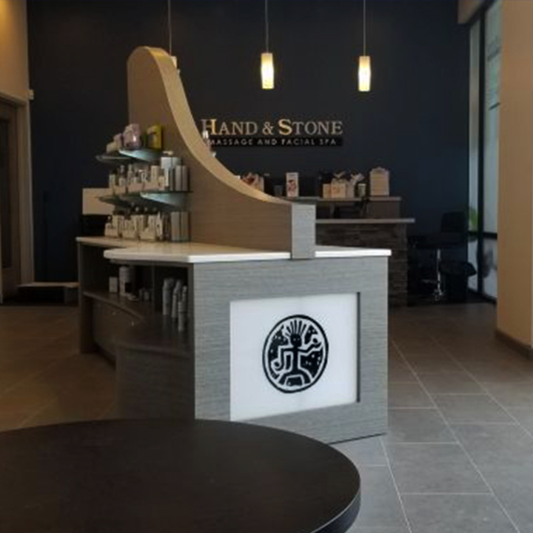
Mission Stament: Our mission is to maintain a legacy of excellence and integrity by consistently providing construction and construction management with superior results through proactive collaboration with our clients and the project team. Work Safety: Ceron’s policy is to provide a safe and healthful place of work that is free of recognized hazards. Ceron believes that a safe and healthful site comes from involvement of all personnel working together to assure that no harm come to person(s) or property as a result of the work that occurs on it’s job sites.

Slide 17
Pre-Construction Services: Our pre-construction services process includes comprehensive analysis of all aspects of your project before the start of construction. Throughout this phase, we work with the Owner and design team to help assure that the cost, scope and schedule of the work is within the Owner’s expectations. Some components of our preconstruction process includes real time cost estimating from schematic design to GMP documents, construction phasing and logistics studies, schedule evaluations, value engineering suggestions, constructability studies, market analysis support of the governmental approval process, and more. Together, working as a project team, the preconstruction process allows for informed and timely decision making to ensure predictable result prior to the start of construction.

Slide 18
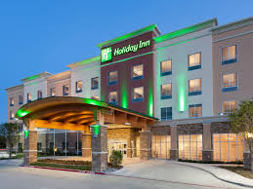
Comprehensive Construction Services: Teamwork is central to our approach to building. Ceron is adept at innovating through preconstruction and construction phase services with owners and designers as construction managers and/or General Contractors. In this role our seasoned managers work thru every facet of a project from conception estimating to closeout. We also provide competitive pricing and exceptional performance assuring the role as builder under general construction arrangement.
Over 40 Year of Experience: Ceron’s tri-state longevity since 1979 is a testament to the depth of our tradition of excellence. Ceron’s dedication to clients, commitment to hard work, and superior results will ensure our continued success.

